Slide 1

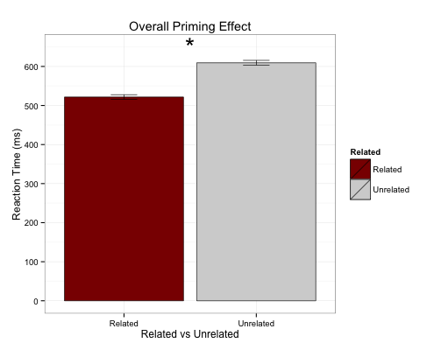
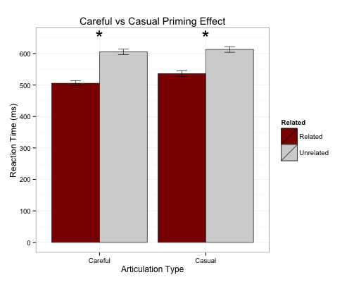
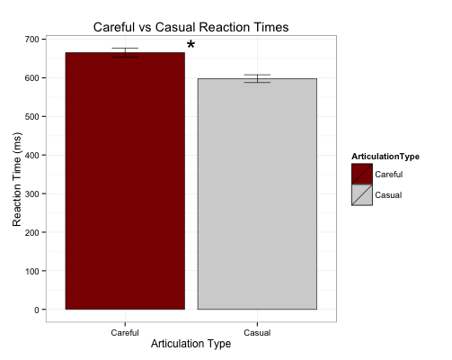
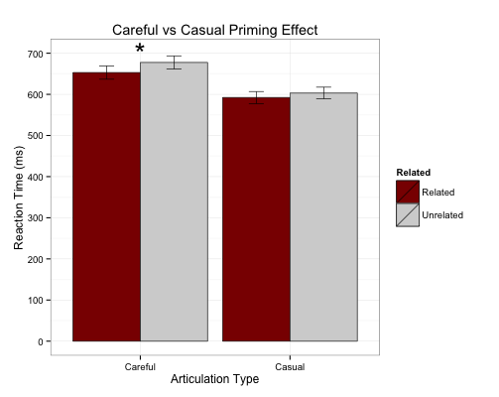
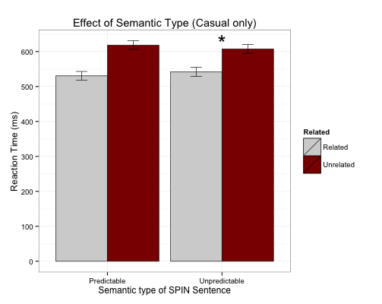
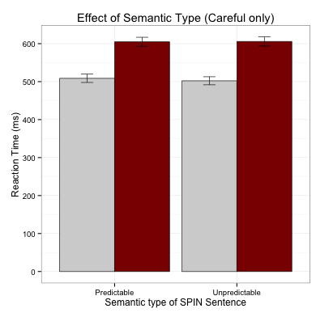

Differences in the recognition of careful and casual speech.
Meghan Sumner, Annette D'Onofrio, Kevin B. McGowan, Teresa Pratt, & Jeremy Calder • Department of Linguistics, Stanford University
[stæ̃ɱfɚd fənɛɾɨks]
2pSCb17
What is the contribution of form and meaning to the processing of careful and casual speech?
Background
Experiment 1: Probe after sentence
Experiment 2: Probe during sentence
Discussion
Research in word recognition is split regarding whether careful or casual speech facilitates word recognition better:
Benefit for careful: Careful speech provides more cues in the signal, facilitating word recognition more completely than casual speech
Benefit for casual: Stronger activation for more frequently experienced forms (e.g. casual forms), as compared to less frequent ones (e.g. careful forms)
Recognition equivalence. Carefully articulated and casually-articulated productions with different variants are understood equally well in form and meaning-based tasks.
What are the effects of form-repetition and semantic predictability
on word recognition across speech style?
Decoupling meaning from form,
how does part of a carefully-articulated word
compare to an entire casually-articulated word?
Strong priming across speech styles
Strong priming resulted for both careful and casual speech in Exp. 1.
Semantic predictability played no role in probe recognition following careful speech, but was a strong predictor for probe recognition following casual speech.
All probes came after the end of the word in Exp. 1, and we expect strong facilitation to occur across speech styles.
How then are words with vastly different production rates are recognized equally well by listeners?
This might be best explained with an updated view of cluster representation
Participants: 48 Stanford University undergraduates
Between Subjects Design: randomly assigned to one of 8 Careful or Casual stimulus lists
Critical Trials: 24 predictable sentence, related probe pairs; 24 predictable, unrelated pairs; 24 unpredictable, related pairs; 24 unpredictable, unrelated pairs
Filler Trials: 24 filler, related pairs; 24 filler, unrelated pairs; 144 filler, pseudoword pairs
Probe Location: Visual probe after full auditory stimulus
The signal may be reduced in casual speech as compared to careful, but more words can be uttered in the same amount of time
Participants: 41 Stanford University undergraduates (preliminary data)
Critical Stimuli: Stimulus presentation identical to Experiment 1 but only Predictable sentences are considered critical stimuli
Probe Location: Visual probe during full auditory stimulus
Auditory Prime
Visual Lexical Decision
Casual Condition
Visual target presented at end of the first semantically-related word
Careful Condition
Visual target presented during first semantically-related word (word onset + casual word duration)
One Hypothesis
Careful
100 ms
(related)
Discrepancy comes from task/stimulus differences and Equivalence comes from differential processing
The cow was milked in the barn
barn
coin
Careful speech relies heavily on signal-based processing
Casual speech relies heavily on knowledge-based processing
Casual
100 ms
(unrelated)
Auditory Prime
Visual Lexical
Decision
A schematic of pronunciation variant frequency (A), phonetic frame frequency (B), and cluster representation (C) for words ending in three t-final variants (used here as symbolic of other kinds of variation). As depicted, the frequency of two atypical pronunciation variants may be the same, but their relationship to the typical production may differ in terms of word-level phonetic variation.
If supported, we would expect to find evidence of:
Stronger effects for casual speech than careful speech in Meaning-based tasks
Stronger effects for careful speech than casual speech in Form-based tasks
Results: Experiment 1
Careful
(related)
Meaning-based tasks and
the serial nature of speech
When a visual probe is presented at the end of a casually-articulated word, but part-way through a carefully-articulated word priming was found only for careful speech.
But, responses to probes following casual speech were extremely fast to related and unrelated visual targets.
We cannot rule out a floor effect, and believe that is what we are seeing.
Future studies investigating the time course of processing with greater resolution will provide insight this initial finding.
Overall related words recognized faster than unrelated words (β=0.19; t=18.77; p < 0.001)
Effect stronger for careful than casual speech, though strong priming for both (β = 5.95; t=137.
13; p < 0.001)
The cow was milked in the barn
barn
coin
Casual
(unrelated)
The cow was milked in the barn
Stimuli
192 SPIN test sentences recorded in careful and casual speech styles, all by the same speaker, for a total of 384 critical stimuli.
Sentences were paired with a target so that each critical stimulus =
an auditory prime (spoken sentence) + a visual target (printed word).
Critical stimuli varied in 3 ways:
Auditory stimuli is spoken in careful or casual speech style
Visual target is semantically predictable or unpredictable, given keywords early in the SPIN sentence
Visual target is related or unrelated to the auditory probe
Results: Experiment 2
 | Predictable |  |  | Unpredictable
 | Unrelated | Related | Difference | Unrelated | Related | Difference
Careful | 604.93 | 508.78 | 96.15 | 605.73 | 502.21 | 103.52
Casual | 618.41 | 530.64 | 87.77 | 607.58 | 541.84 | 65.74
Responses to casual speech faster than to careful speech (β=-0.11; t=-2.08; p <0.05)
Conclusions
We investigated whether equivalence across speech styles results from different dependency on form-based and meaning-based information.
Shifting to a sentential priming paradigm, at sentence-end, all speech styles result in strong priming.
Semantic predictability was critical for casual speech, but not for careful speech, suggesting form-based mapping is stronger for the latter.
In meaning-based tasks, casual speech appears to bottom out, and strong priming ensues for careful speech, though responses are much slower than those found for casual speech.
We expect competition effects in a visual world paradigm to replicate these asymmetries
Semantic predictability effects recognition of words following casual but not careful speech(β=-0.038; t=-2.36; p<0.05).
Predictable words are recognized faster than unpredictable words in casual speech condition.
Priming effect found for careful speech (β=0.04; t=3.31; p <0.01), but not casual speech
 | Auditory probe (spoken) | Target word (visual)
Predictable: Related Unrelated | The cow was milked in the barn. The cow was milked in the barn. | BARN COIN
Unpredictable: Related Unrelated | I am thinking about the barn. I am thinking about the barn. | BARN COIN
Lack of priming for casual likely due to floor effect: Lexical decision to visual targets extremely fast when preceded by casual probes. With greater power and/or a more sensitive paradigm, the effect is likely to emerge.
Results suggest form-based effect for careful speech and meaning-based effect for casual speech
This material is based upon work supported by the National Science Foundation Grant No. 1226963 to Meghan Sumner.
Any opinions, findings, and conclusions or recommendations expressed in this material are those of the author and do not necessarily reflect the views of the National Science Foundation.
Questions? E-mail Meghan (sumner@stanford.edu)

